Slide 1
A deep dive into SharePoint 2016 architecture and deployment
Jussi Roine
Notes:
This slide is mandatory. Please do not remove.

Slide 2

Jussi Roine
CTO, MVP, MCM, MCT
Onsight Helsinki
www.jussiroine.com
@JussiRoine
Novice yoga enthusiast, semipro rock climber, horrible chef

Slide 3
Notes:
This slide is mandatory. Please do not remove and try to use it during Q&A at the end of your session. Thank you!

Slide 4
High fives!
Deployment & patching
We made it!
Architecture
Scalability & high availability

Slide 5
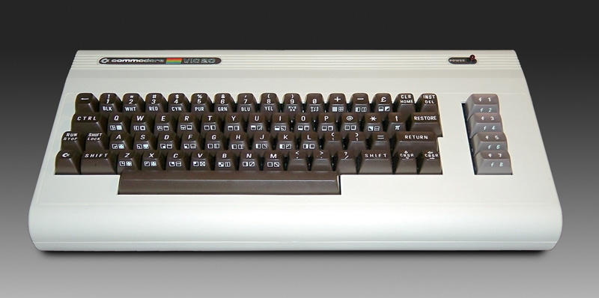
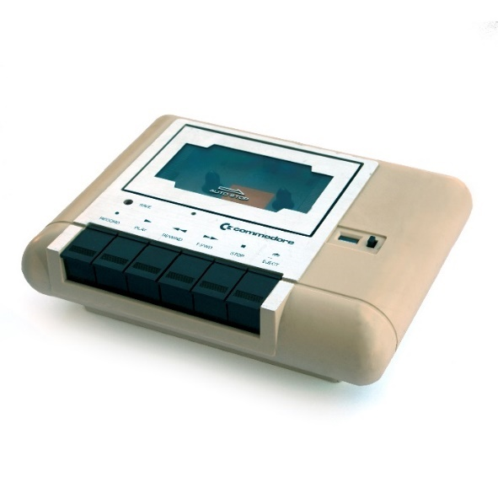

1981

Slide 6
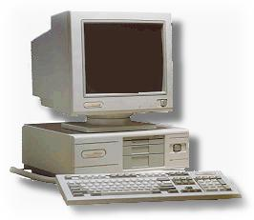
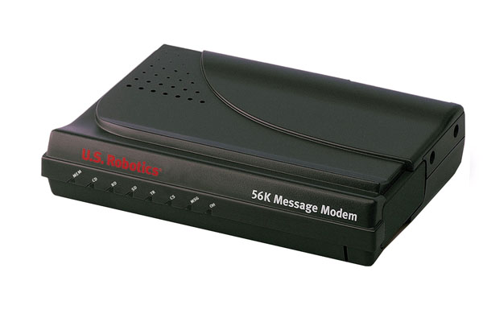
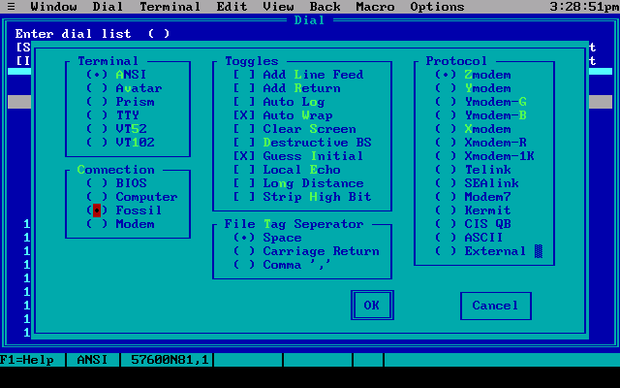
1991

Slide 7

My Spanish skills
Ella come la manzana
La cucaracha

Slide 8
Architecture

Slide 9
Hardware requirements for SharePoint 2016
Physical servers must be in the same network
Stretched farm is supported with <1ms intra-latency and 1 Gbps Ethernet connections
Installation scenario | Deployment type and scale | RAM | Processor | Hard disk space
Single server role that uses SQL Server | Development or evaluation installation | 16 GB | 64-bit, 4 cores | 80 GB for system drive 100 GB for second drive
Single server role that uses SQL Server | Pilot or user acceptance test installation | 24 GB | 64-bit, 4 cores | 80 GB for system drive 100 GB for second drive and additional drives
Web server or application server in a three-tier farm | Development or evaluation installation | 12 GB | 64-bit, 4 cores | 80 GB for system drive 80 GB for second drive
Web server or application server in a three-tier farm | Pilot, user acceptance test, or production | 16 GB | 64-bit, 4 cores | 80 GB for system drive 80 GB for second drive and additional drives

Slide 10
Software requirements
Item | Required
Operating System | Windows Server 2012 R2 (Windows Server 2016 support is coming later)
Prerequisites | Web Server (IIS) role Application Server role Microsoft .NET Framework version 4.5.2 Microsoft SQL Server 2012 Native Client Microsoft WCF Data Services 5.6 Microsoft Information Protection and Control Client (MSIPC) Microsoft Sync Framework Runtime v1.0 SP1 (x64) Windows Management Framework 3.0 which includes Windows PowerShell 3.0 Microsoft Identity Extensions Windows Server AppFabric 1.1 Cumulative Update Package 1 for Microsoft AppFabric 1.1 for Windows Server (KB 2671763) Microsoft ODBC Driver 11 for SQL Server Update for Microsoft .NET Framework to disable RC4 in Transport Layer Security (KB2898850) Visual C++ Redistributable Package for Visual Studio 2013
.NET Framework | .NET Framework 4.5.2
Database | SQL Server 2014 SP1 or newer / SQL Server 2016 support: June 1st when available

Slide 11
Software boundaries and limits
Guidance updated for SharePoint 2016: http://bit.ly/sp16limits
Updates and changes
Limit | Maximum value | Limit type | Notes
File size | 10 GB | Boundary | The default maximum file size is 250 MB. This is a configurable limit that can be increased up to 2 GB (2,047 MB). However, a large volume of very large files can affect farm performance.
List view threshold | greater than 5,000 | Threshold | Specifies the maximum number of list or library items that a database operation, such as a query, can process at the same time outside the daily time window set by the administrator during which queries are unrestricted. When adding or removing a column index, the threshold is 20,000 by default. When deleting a list or folder, the threshold is 100,000 by default. When renaming a folder within the same library, the threshold is 100,000 by default.

Slide 12
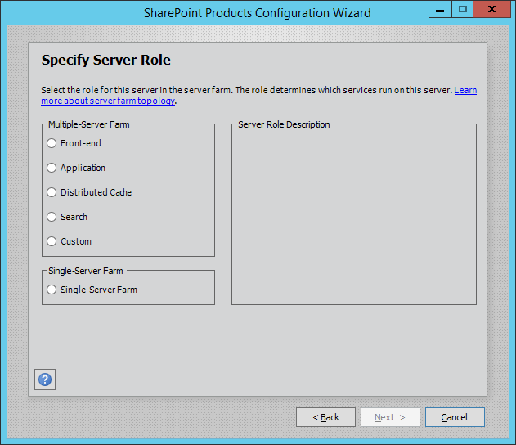
What is MinRole?
Ability to create SharePoint farms based on pre-defined server roles
Each role maps to pre-defined services, rules and settings on a server
Roles together include all services in a SharePoint farm
Option to build a single-server farm still exists

Slide 13
Why MinRole?
Simplified deployment
Deploy a role, and you’ll get a role
No need to tweak the services per server
All deployments follow the same rules & models
Improved performance and reliability
Optimization based on Office 365 findings and learnings
Simpler capacity planning
Predictable and easier to manage
Easy to scale – just add n servers to y roles

Slide 14
MinRole roles and services
Role | Contains
Web Frontend | End user requests and services, such as SharePoint Foundation Web Application, Administration, Managed Metadata Web Service etc.
Application | Backend jobs and services, such as Machine Translation Service, App Management Service and Word Automation Service
Search | Search related services, such as Host Controller Service, Search Query and Site Settings Service
Distributed Cache | Distributed cache services for the farm
Custom | A custom combination of services and tasks

Slide 15
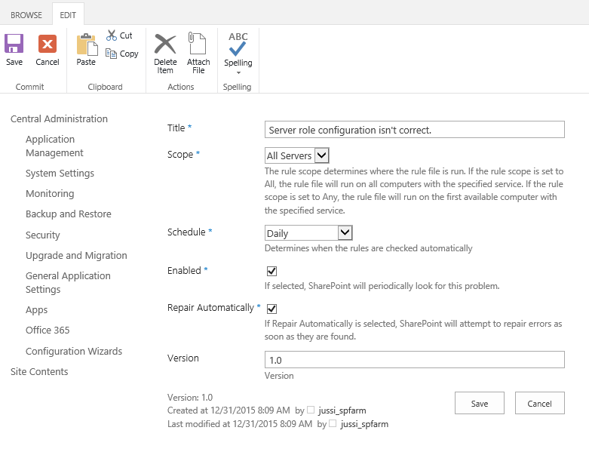
MinRole health monitoring
Health monitoring for MinRole is built into Health Analyzer
Automatic repair for all MinRole roles except Custom
You can disable auto-repair easily, enabled by default
Single-Server Farm cannot coexist with MinRole roles

Slide 16




MinRole topology
Smallest supported MinRole farm is 4 servers
Smallest MinRole farm with high availability is 9 servers
Search
Application
Distributed
Cache
Web Front end
7
Search
Application
Distributed
Cache
Web Front end
Search
Application
Distributed
Cache
Web Front end
Distributed
Cache

Slide 17
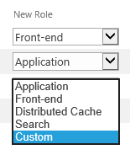
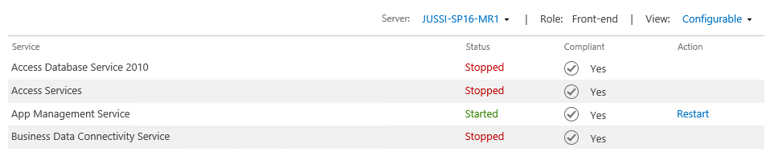
Managing MinRole
Change or specify server role with PowerShell
Set-SPServer –Role { WebFrontEnd | Application | SingleServer | SingleServerFarm | DistributedCache | Search | Custom }
Change or specify server role with Central Admin

Slide 18
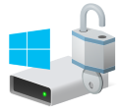
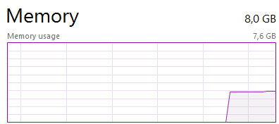
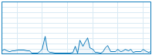
My own SharePoint 2016 farm setup
Hyper-V host
AD: transmogrifier.local
Active Directory
Domain Controller
WFE
CA
App
CA
Search
Distributed Cache
Custom
Project Server
OOS
SQL Server 2016
RC3
CPU
64,0 GB
500 GB

Slide 19
MinRole
How many servers needed for the following requirements?
MinRole
MinRole high availability
Custom apps/add-ins
Workflow Manager
Office Online Server
Databases
4
+3
+2
+3
+2
+2
16

Slide 20
Sample topology for a large production intranet platform
Load balancing & DNS
Web frontends
Custom add-ins
App Servers and CA
Office Online
Server
Workflow
Manager
Distributed Cache
Backend:
AD, Databases, MIM

Slide 21
Deployment

Slide 22
Distributed Cache
NTLM authentication is not used in SharePoint 2016
This applies to calls between cache cluster and SharePoint
Relies now on encryption of cache data before transport
Scales up number of clients that can be served
SharePoint shouldn’t be more unresponsive under high load now
Distributed Cache is enabled (by default) only on SingleServerFarmRole and Cache roles

Slide 23
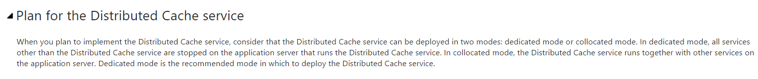
Distributed Cache
Dedicated vs. Collocated
Microsoft recommendation for SP2013 on Technet:
Licensing implications?
Is it worth it?
One or more Distributed Cache hosts?

Slide 24
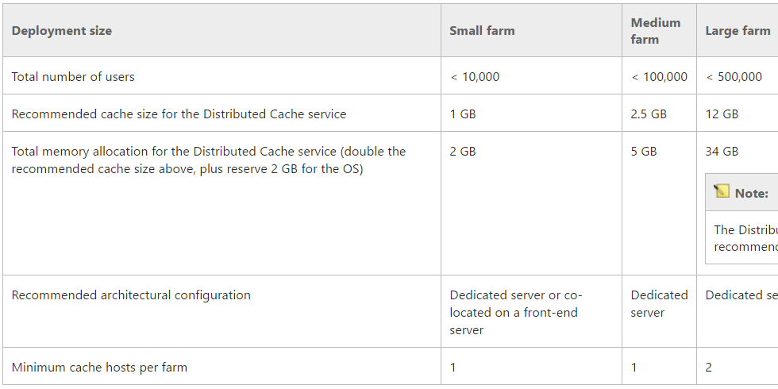
Distributed Cache high availability
Get-AFCache | % {Get-AFCacheConfiguration -CacheName $_.CacheName}
CacheName : DistributedViewStateCache_f3bd4763-f482-4bb8-a5a5-f40806460bdd TimeToLive : 10 mins CacheType : Partitioned Secondaries : 0 MinSecondaries : 0

Slide 25
Deployment method 1: GUI Installation
Install everything manually: the ”Next-Next” install)
Pros | Cons
Very easy ☺ | Hides a lot of logic and configures things with potential issues
Errors trapped in the UI | Re-running setup might fix errors, or introduce new issues
Fastest way | Also the ugliest way! Just look at it.
Download Prerequisites online (prerequisitesinstaller.exe)
Reboot
Run Setup
Run Configuration Wizard

Slide 26
Deployment method 2: Custom PowerShell
Create custom PowerShell deployment scripts
Pros | Cons
Deployment can be customized | Requires a lot of work for end-to-end custom scripts
Can be automated and fully controlled | Error-prone
1) Install prerequisites online
2) Run custom provisioning scripts
3) Finalize with GUI if needed

Slide 27
Deployment method 3: AutoSPInstaller
Provision using AutoSPInstaller
Pros | Cons
Repeatable templates | Open source and ”community supported”
Very good for larger deployments | You might not know what’s being deployed
Prepare installation media with AutoSPSourceBuilder
Create template for AutoSPInstaller with AutoSPInstaller Online
Download AutoSPInstaller + copy media files
Execute install and get coffee
Done!

Slide 28
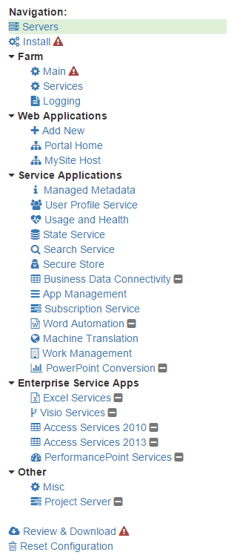
AutoSPInstaller
https://autospinstaller.com/
Beta support for SharePoint 2016
Also supports Windows Server 2016 Technical Previews (well, TP3 at least)
Support for SQL Server 2016 CTP is not officially there, but works
I tried ☺

Slide 29
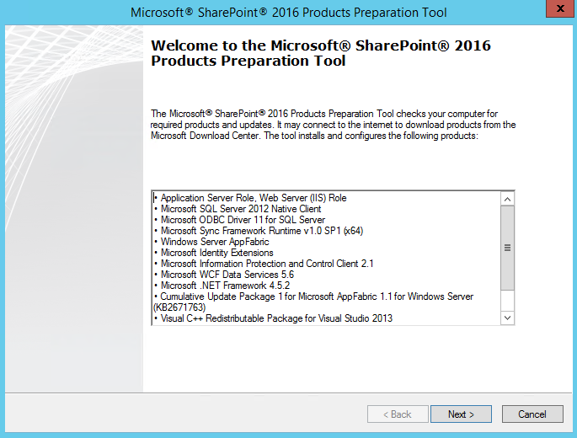
Installation: Prerequisites
Use Prerequisiteinstaller.exe
Offline install with http://bit.ly/sp16offline
Reboot when finished
First server hosts Central Admin
Note! 2 cores for each server

Slide 30
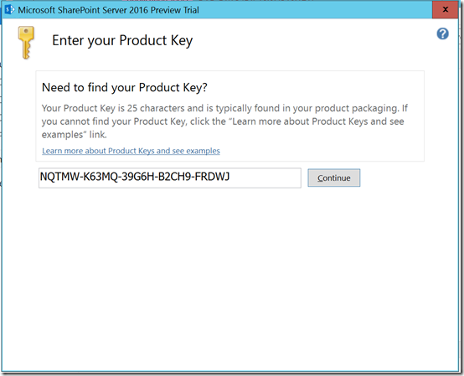
SharePoint 2016 installation

Slide 31
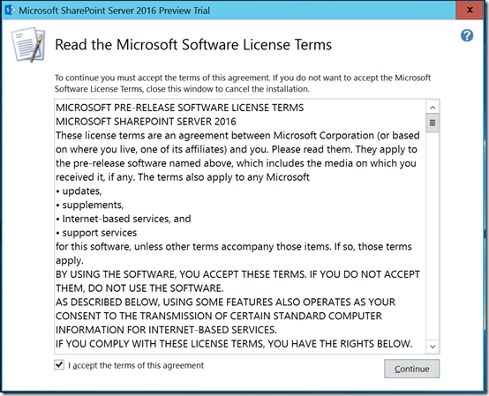
SharePoint 2016 installation

Slide 32
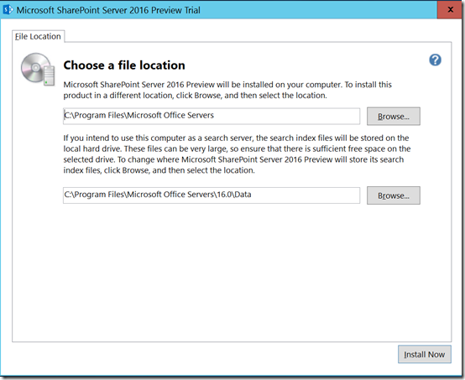
SharePoint 2016 installation

Slide 33
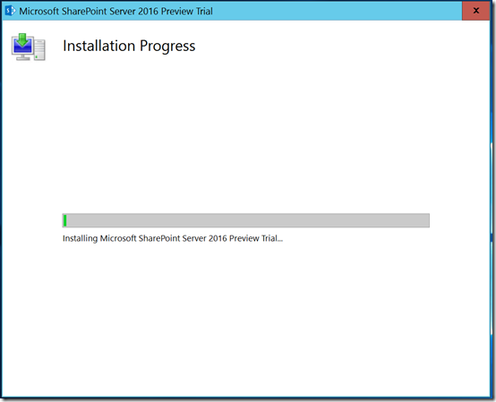
SharePoint 2016 installation

Slide 34
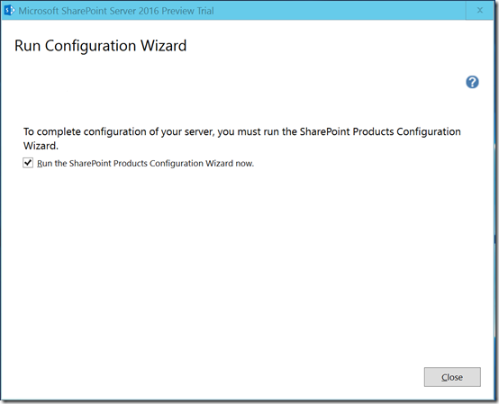
SharePoint 2016 installation

Slide 35
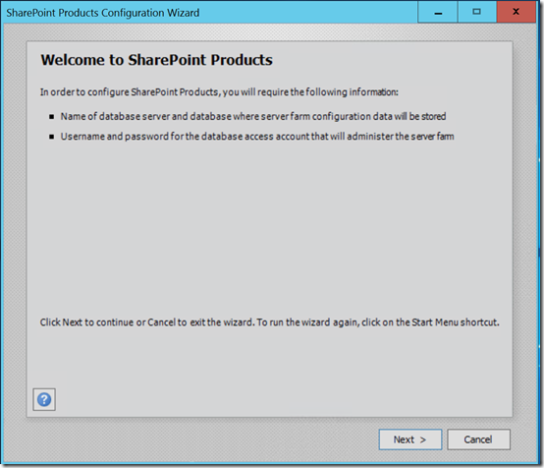
SharePoint 2016 installation

Slide 36
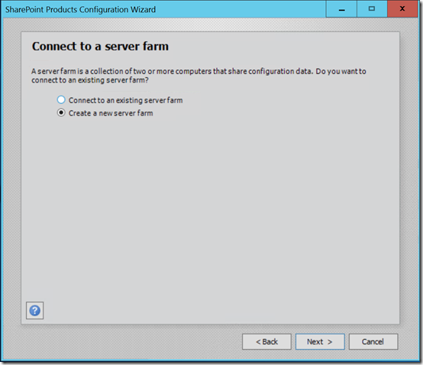
SharePoint 2016 installation

Slide 37
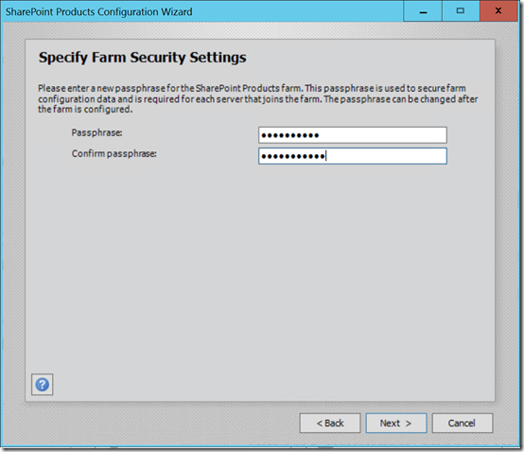
SharePoint 2016 installation

Slide 38
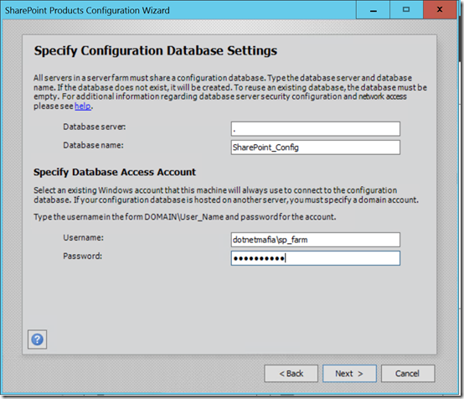
SharePoint 2016 installation

Slide 39
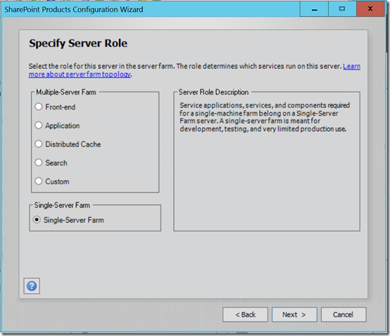
SharePoint 2016 installation

Slide 40
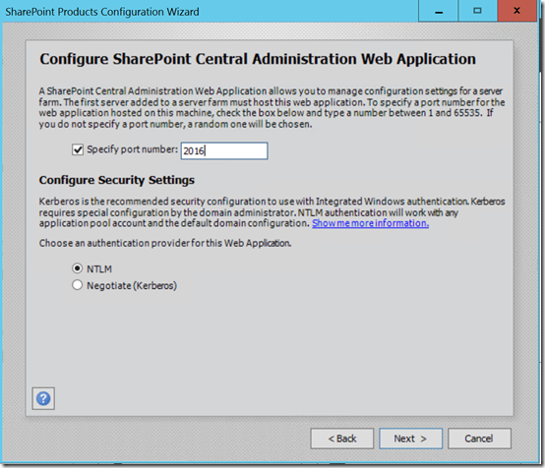
SharePoint 2016 installation

Slide 41
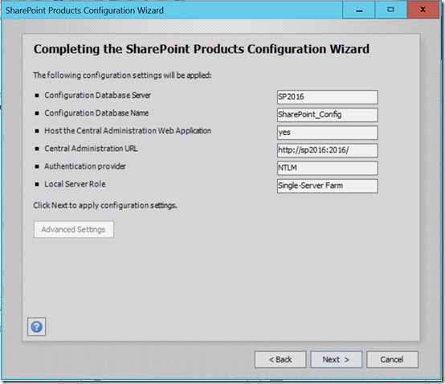
SharePoint 2016 installation

Slide 42
Installing with AutoSPInstaller

Slide 43
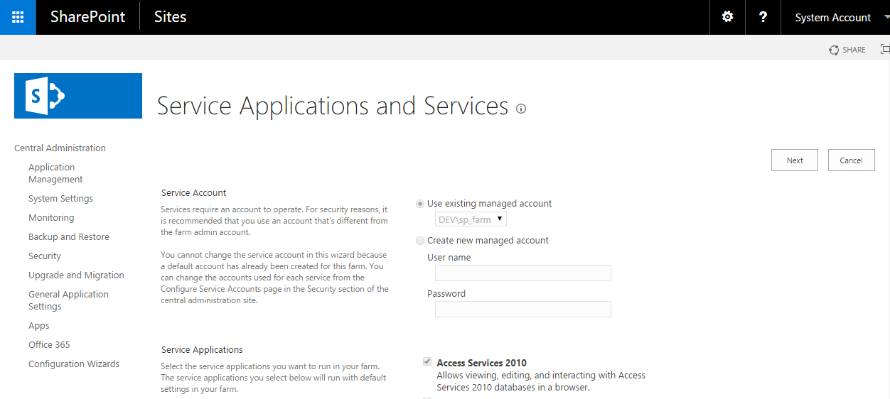
SharePoint 2016 installation

Slide 44
Zero Downtime Patching
Updates are delivered as patches
Each patch has only a few (2-3) packages
Instead of 30-50 as with SP2013
Patching is very fast: minutes, not hours
Changes are in server-side patching & database changes
Current builds
16.0.4107.1002 IT Preview
16.0.4306.1002 Beta 2
16.0.4336.1000 Release Candidate
16.0.4351.1000 RTM

Slide 45
Patching SharePoint 2016
In-Place Upgrade
2 Phase process
Patching
Upgrade
Patching and upgrade are online operations
All roles must have HA to achieve “zero downtime”
Web frontends
App & Search
Distributed Cache
AD & Databases

Slide 46
Patching example
Patching approach from 4351 to a future patch (post-RTM)
Run PSConfig
Repeat on each farm server
Slipstreamed installs are not yet supported
Note: (Get-SPFarm).BuildVersion might not be updated, if there are no database level changes
Baseline install
Build 16.0.4351.1000
Patch prerequisites install
Build 16.0.xxxx.xxxx
Patch install
Build 16.0.xxxx.xxxxx

Slide 47

Process for patching with Zero Downtime
Remove WFE from LB and patch
Patching is complete
Run Upgrade-SPContentDatabase in parallel
Run .\psconfig.exe -cmd secureresources -cmd installfeatures -cmd upgrade -inplace b2b -force -wait -cmd applicationcontent –install on app servers
Remove WFE from LB and run PSConfig
Repeat for all WFE’s
Patch each App server individually
Backup the farm
Upgrade complete
Verify BuildVersion

Slide 48
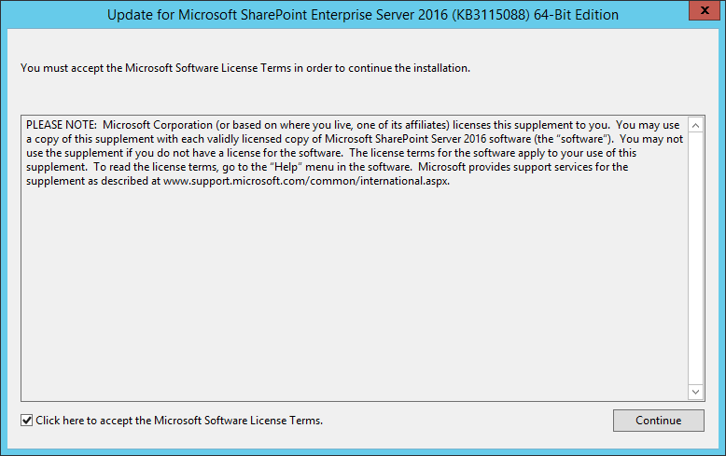
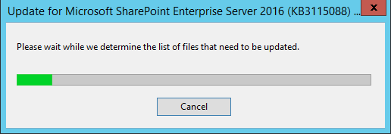
Performing Zero Downtime Patching

Slide 49
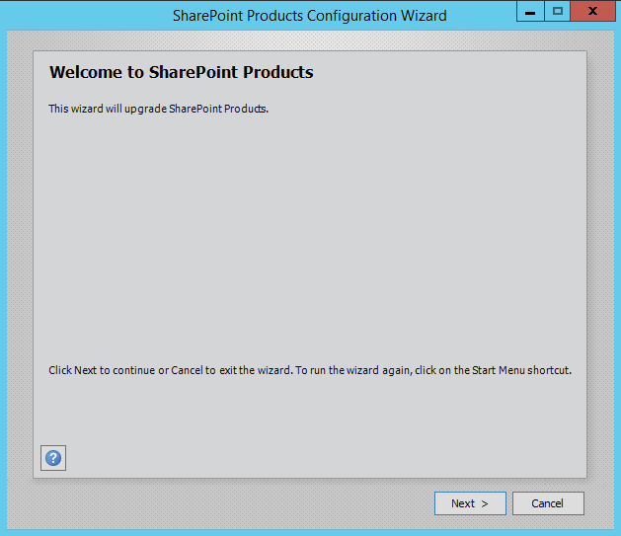
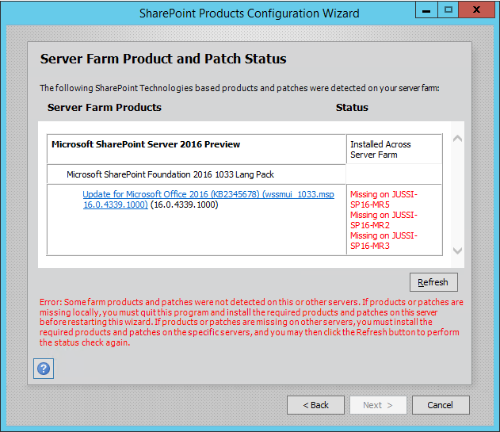
Performing Zero Downtime Patching

Slide 50
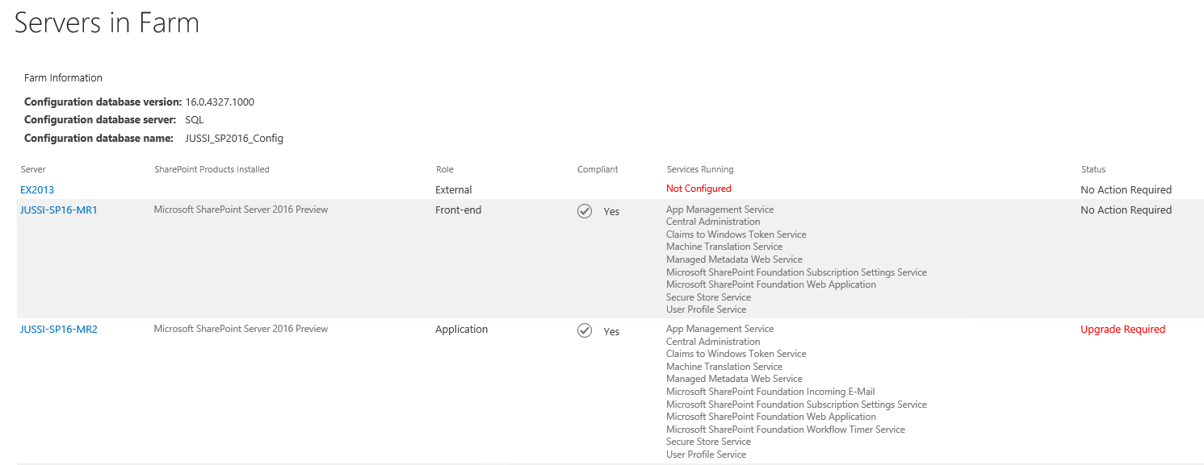
Performing Zero Downtime Patching

Slide 51
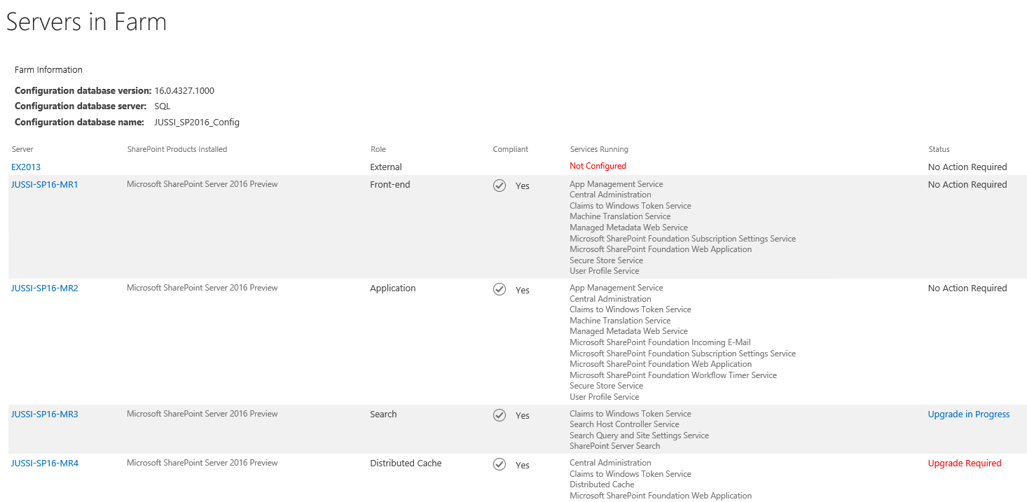
Performing Zero Downtime Patching

Slide 52
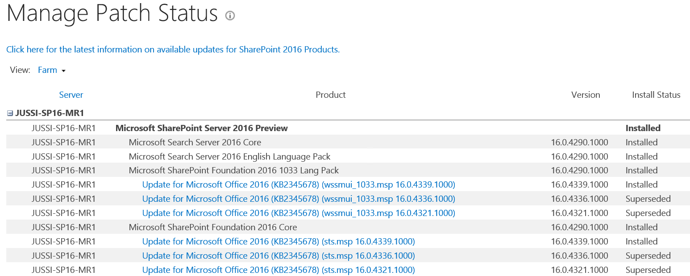
Performing Zero Downtime Patching

Slide 53
Scalability and High Availability

Slide 54
High availability and SharePoint
Always balance your architecture against real business needs
With MinRole, HA is possibly easier to achieve and manage
HA is not just about ”enough servers”
It’s about planning for a solid architecture, of which HA is a by-product
You can also get HA without MinRole
Consider what your HA level is
Single Server
A lot of options here
Full HA with MinRole

Slide 55
The road to High Availability & Performance
Use SQL alias for database connections
Cliconfg.exe is your friend → AutoSPInstaller does this for you
For SQL Server, perform the following changes
Enable Lock Pages in Memory
Set Max Degree of Parallelism (MAXDOP) to 1
Configure Max Memory Settings
Configure Tempdb to reduce page allocation contention
Locking pages may boost performance when paging memory to disk
To configure:
Run gpedit.msc
Go to Security Settings > User Rights Assignment
Lock pages in memory: Add account that has privileges to run sqlservr.exe
Log out & log in
May boost performance
To configure:
Right click server in Management Studio
Select Advanced node
Set Max Degree of Parallelism to 1
Optimal memory settings
To configure:
Deduct 4 GB from current system memory
Right click server in Management Studio
Click Memory node
Set max memory to (current RAM – 4GB)
This has a substantial performance impact
To configure:
Open SQL Server Configuration Manager
Select SQL Server Services
Right click MSSQLSERVER and select Properties
Add a new startup parameter: -T1118
Restart SQL Server service

Slide 56
The road to High Availability & Performance
Configure SQL Server AlwaysOn Availability Groups
Guidance https://technet.microsoft.com/en-us/library/jj715261.aspx
Consider MinRole allocations and the need for MinRole
Configure Log Shipping for Disaster Recovery
Guidance http://technet.microsoft.com/en-us/library/ms190640.aspx

Slide 57
The road to High Availability & Performance
Modify Model and Tempdb settings
Increase initial size
Autogrowth to MB, not % based increments
For Tempdb, use simple recovery model
Multiple tempdb files on multiple drives
Avoid using auto shrinking for databases

Slide 58
The road to High Availability & Performance
Configure HTTP Compression for Static and Dynamic Content in IIS
appcmd set config /section:urlCompression /doStaticCompression:True
appcmd set config /section:urlCompression /doDynamicCompression:True
Configure Distributed Cache
Memory allocation to “current OS memory - 2 GB divided by 2 = cache allocation size
https://technet.microsoft.com/en-us/library/jj219613.aspx#memory
Verify that Background Garbage Collection is enabled
<appSettings><add key="backgroundGC" value="true"/></appSettings>
Set Content App Pool permission
Grant-CacheAllowedClientAccount –Account “DOMAIN\SP_AppPool”

Slide 59
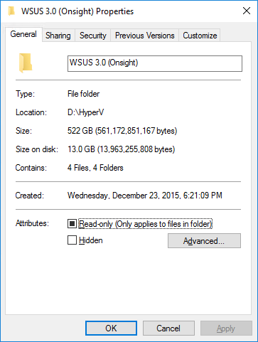
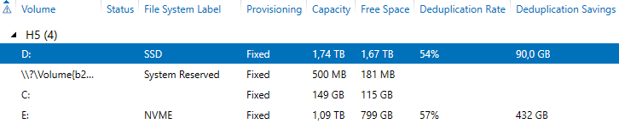
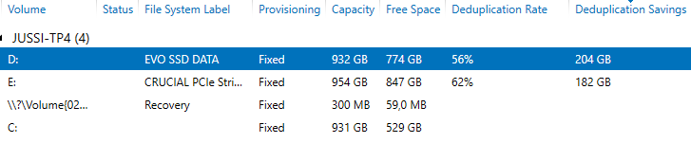
Data deduplication with SharePoint 2016
Windows Server 2016 TP4 (and newer) support data deduplication with Hyper-V role

Slide 60
SharePoint and Resilient File System
Resilient File System, supported since Windows Server 2012
Maximizes data availability
Automatic correction from corruption (with Storage Spaces)
Optimized for high scalability
Available also on Windows 8.1 and Windows 10
See here for administrative guidance
System cannot boot from ReFS → a good candidate for everything else (logs, backups, search)
Not ideal for SQL databases, as DBCC CHECKDB cannot be executed online

Slide 61
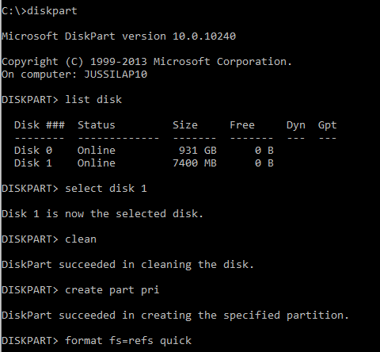
Enabling ReFS
Add a registry key
HKEY_LOCAL_MACHINE\SYSTEM\CurrentControlSet\Control\MiniNT
AllowRefsFormatOverNonmirrorVolume (DWORD): 1
Reboot
Use DiskPart to format disk for ReFS

Slide 62
Recap
MinRole gives a lot, but also demands quite a lot
Optimize SQL Server and Distributed Cache
Deploy using AutoSPInstaller
Zero Downtime Patching is costly but achievable

Slide 63
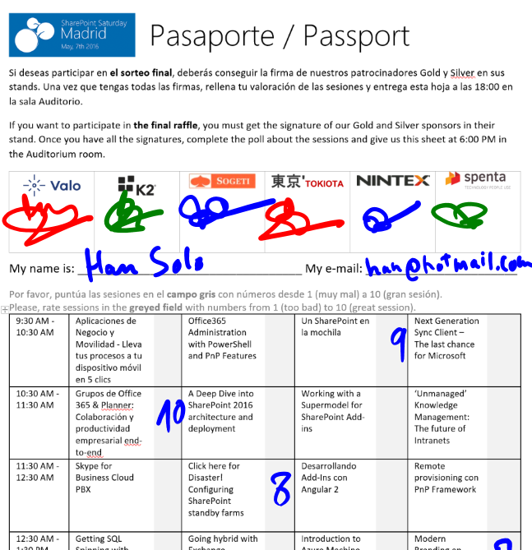
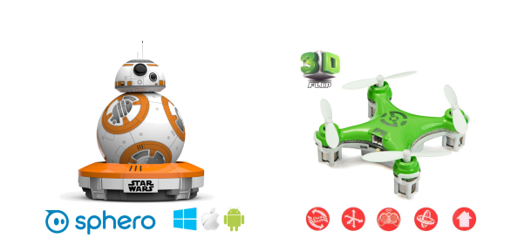
Raffle
Please, fill your SPS Madrid passport if you want to participate.
You must get signature from sponsors and complete the poll.
Give us the passport at 6:00 PM in the Auditorium room.
You can win one Sphero BB-8 or a mini drone:

